Slide 1


The Traveler’s
PATH TO PURCHASE

Slide 2

30 MILLION DIGITAL CANADIAN USERS
CONSUMING
148 BILLION DIGITAL MINUTES
EACH MONTH
Data Source: comScore Media Metrix Multi-Platform Reporting, CA, April 2016 data, Unique Visitors & Total Minutes.

Slide 3

7 OF 10
DIGITAL CANADIAN USERS
CONSUME TRAVEL CONTENT
Data Source: comScore Media Metrix Multi-Platform Reporting, Canada, April 2016 data, Share of Total Monthly Internet Unique Visitors Visiting Travel Content.

Slide 4
DIFFERENT AGE GROUPS ENGAGE SIMILARLY IN ONLINE AND OFFLINE TRAVEL RESEARCH.
All Resources Used
C
TOTAL
(n=815)
MILLENNIALS
(A=275)
GEN X
(B=344)
BABY BOOMERS
(C=196)
Data Source: comScore Survey, RESOURCECA. WHAT ARE ALL THE RESOURCES YOU USED PRIOR TO BOOKING YOUR MOST RECENT TRIP?, Among Total CA Online Travel Bookers – By Age
A/B/C letters indicate a significant difference between groups at a 95% confidence level.

Slide 5
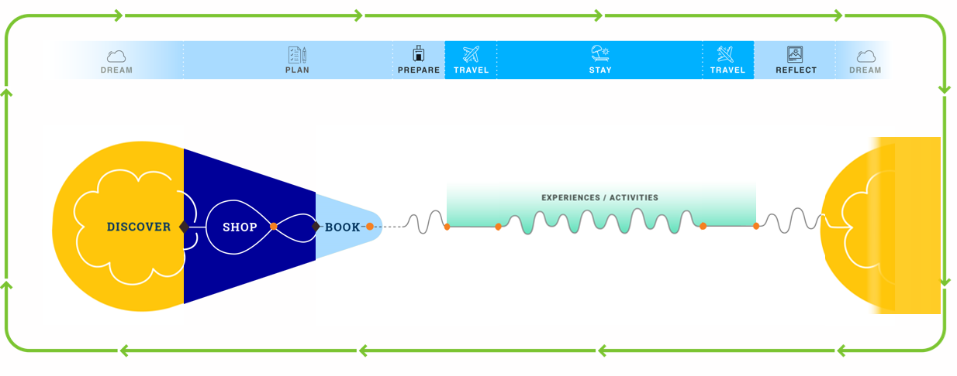
Travelers Online Journey

Slide 6
ONLINE TRAVEL BOOKERS HAVE INCREASING ENGAGEMENT WITH TRAVEL CONTENT THROUGHOUT THE WEEKS PRECEDING A BOOKING EVENT.
Average Travel Site Visits per Week
(Number of travel sites visited per week by the average segment member, Oct’15-Feb’16 aggregate)
By the end of the booking path average visits per booker increased by 132%, resulting in close to daily visits to travel sites, on average.
Number of visits to travel sites made by bookers 45 days before booking:
161
Read as: The average segment member makes 31.3 visits to travel sites in the week leading up to the booking
Data Source: comScore Canada Desktop Panel, Custom Path to Booking Visitation Analysis, Weekly Visits per User, Dec ’15 – Feb ’16.

Slide 7
OTAS HAVE THE MOST ENGAGEMENT OF ONLINE TRAVEL BOOKERS
COMPARED TO TRAVEL SITE CATEGORIES THROUGHOUT BOOKERS’ TRAVEL BOOKING PATHS.
Share of Total Visits
Throughout 45 Online Booking Path
Data Source: comScore Canada Desktop Panel, Custom Path to Booking Visitation Analysis & Categorization, Share of Total Visits per User Across 45 Day Path, Dec ’15 – Feb ’16, Custom Travel Booker Audience Segment.

Slide 8
CLOSE TO TWO-THIRDS OF MILLENNIAL ONLINE TRAVEL BOOKERS START WITH MULTIPLE DESTINATIONS IN MIND.
63%
OF MILLENNIALS TRAVEL BOOKERS CONSIDERED
2+ DESTINATIONS.
Data Source: comScore Survey, DESTINATIONS. PRIOR TO DECIDING ON YOUR FINAL DESTINATION, HOW MANY OTHER DESTINATIONS DID YOU CONSIDER VISITING?, Among Total CA Online Travel Bookers (n=815), Millennials (n=275)

Slide 9







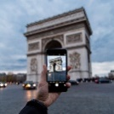






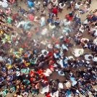

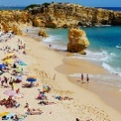





Connecting
TRAVELERS
With
ADVERTISERS
144M+
Unique monthly visitors¹
Marketing partners in
170 countries
2.1B
Monthly page views¹
50+
Targeting types
10 Expedia Group brands
200+
Audience segments
200+ sites
in 75+ countries
20 Unique advertising solutions
150+ mobile sites
in 70+ countries
30
Reporting KPIs
Notes: Expedia, Group data shown as of Q3’18, unless otherwise noted. ¹Expedia Group Global – comScore, July 2018. ²OTA brands Expedia.com + Hotels.com from Q4’17-Q3’18.
Notes:
While you may have heard of Expedia, you may not be familiar with Expedia Group Media Solutions​
We are a marketing platform, connecting travelers with advertisers all around the world.
With more than 200 sites from leading travel brands across 75 countries and 35 languages, we have a truly global audience of qualified travel shoppers
We connect marketing partners in more than 170 countries with our proprietary, first-party data from 144 million monthly unique visitors and more than 2 billion monthly site page views
We can access billions of data points and advertising solutions, including targeting, we help our marketing partners reach the right person at the right time with the right message – wherever they are across the web. (Expedia Group Global Data – comScore, July 2018)
[If relevant, you can verbally share] We work with marketing partners around the world, and last year, we:
Worked with nearly 32,000 marketing partners
Executed more than 40,000 campaigns
Served nearly 25 billion impressions
Delivered nearly 40,000 results reports

Slide 10
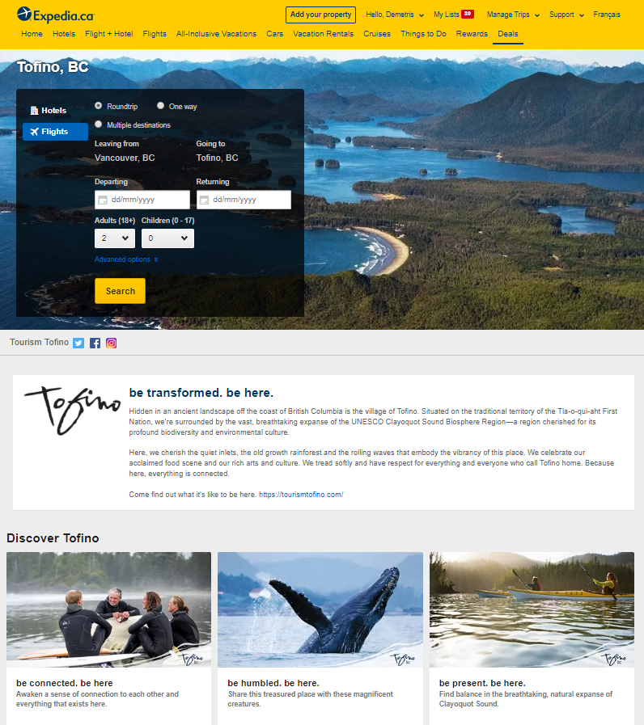
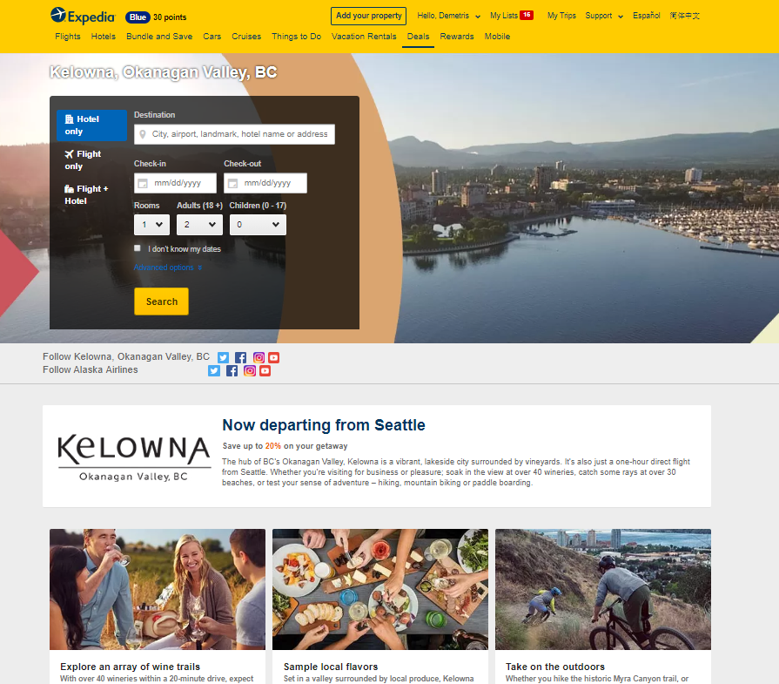
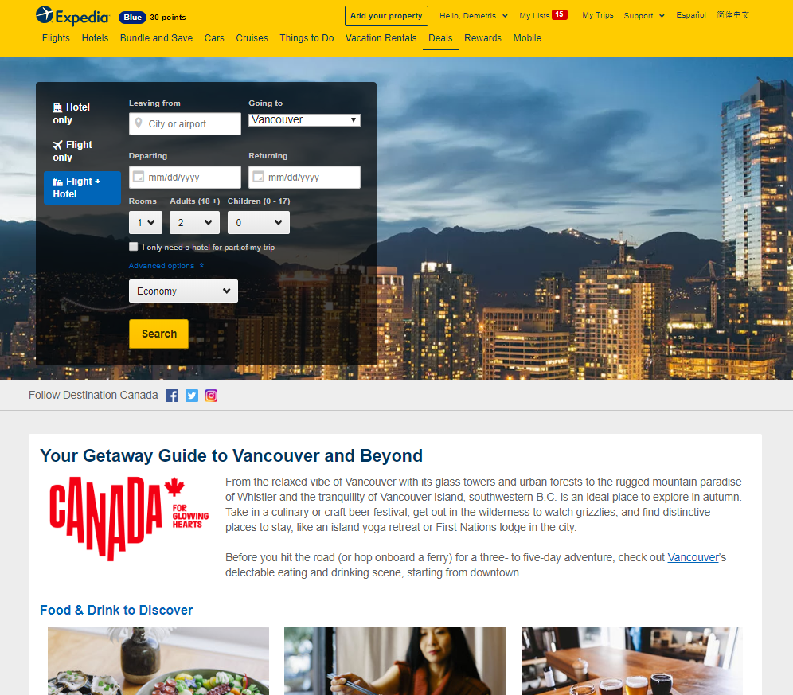
BC Marketing Programs

Slide 11
THANK YOU
www.advertising.expedia.com

