Slide 1
Let’s Talk Travel Media!
Mika Ryan
Global Marketing Partnerships
Destination British Columbia
November 3, 2019
NIMPO LAKE
CARIBOO CHILCOTIN COAST
Notes:
Introduction and thank you to Geoff and Amy.

Slide 2
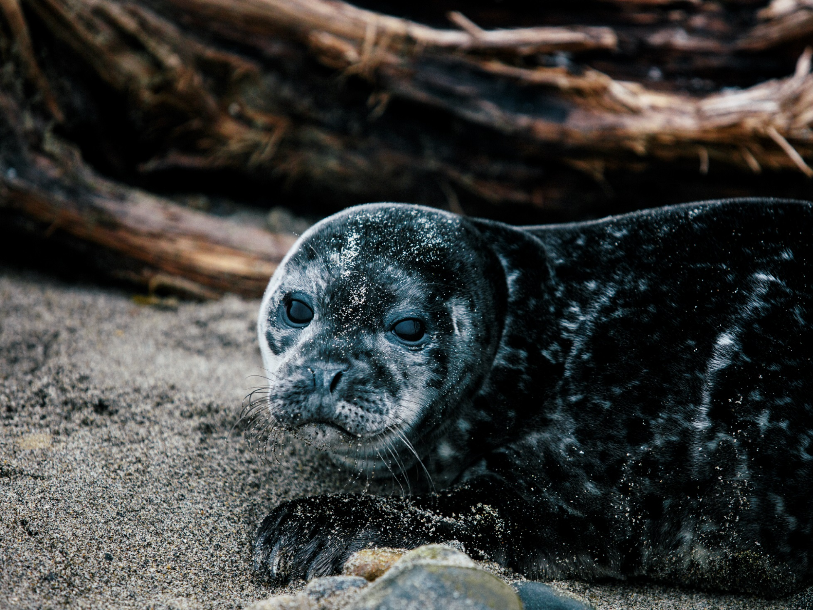
What is Earned Media?
HAIDA GWAII
NORTHERN BC
Notes:
What is PR?
In simplest terms, media relations or public relations (PR) is sending the right message, to the right audience, through the right channel, at the right time.
Unlike advertising, travel media can’t be purchased, so consumers view it as unbiased
At Destination British Columba - Travel media relations is an essential marketing channel to tell our brand story, build awareness and encourage travellers to visit BC.

Slide 3
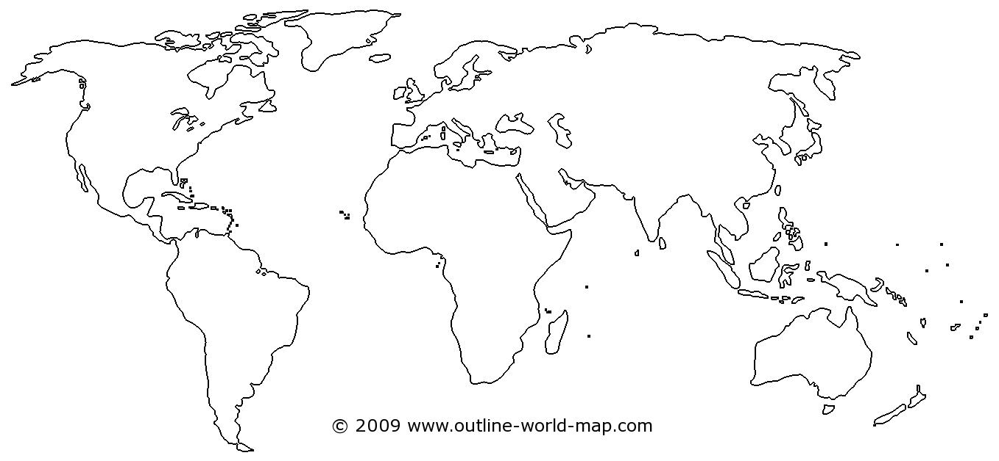
DBC in-market office
2019 GEOGRAPHIC MARKETS
INVEST
US
China
Australia
Mexico
BC
MAINTAIN
UK
Germany
Alberta
Ontario (ski)
MONITOR
Japan
S. Korea
India
France
Notes:
Destination BC has travel media representatives in Vancouver (NA market), London, Frankfurt, Sydney, Beijing, Tokyo and Mexico City –
They’re a great group of people who are working on your behalf and will be a wonderful resource to you.
Our representatives establish very strong relationships with travel media pitching a variety of stories and products many provided through BC DMOs and the tourism industry.
We also align closely with Destination Canada on a number of travel media initiatives.

Slide 4
Notes:
But It really does take a village to run a successful travel media program.
We greatly appreciate working with our regions and industry partners,
your valuable input and support is crucial to our travel media programs success.

Slide 5
Who are the Travel Media?
Magazines, Newspapers, Television, Digital, Social Influencers, Radio, Podcast

Slide 6
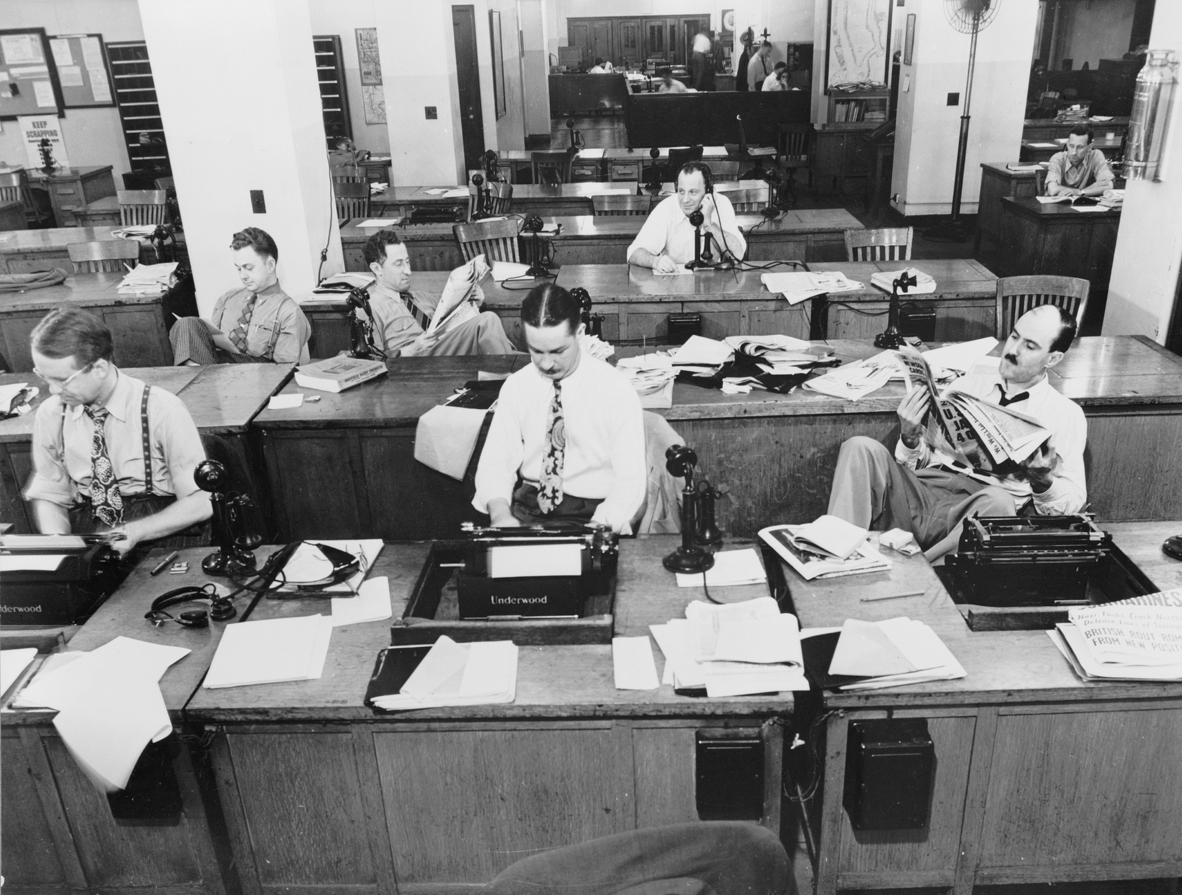
Notes:
The digital revolution has transformed our media world in a big way
and news rooms don’t look the way they used to.
With fewer staff resources, editors rarely travel and they depend on freelancers to help them create content.

Slide 7
Notes:
As a result, most of the media we currently work with are freelancers.
While this creates wonderful opportunities , it also comes with a few challenges.
For instance - Editors rarely provide assignment letters anymore, so we need to relay on other tools to help us determine which journalist we should be working with.

Slide 8
Think Like An Editor
What is your story?
What is the key message that you want to deliver?
Why would a journalist be interested in writing about your business or experience?
What sets your business or experience apart from others?
Who is the audience for the story you want to share?
Notes:
In working with travel media to achieve your goals, you first need to understand their goals.
For travel media to do their job properly, they have some specific needs: they require accurate information, they often need to meet tight deadlines and they need to present a story that appeals to their audience.
If you’re not helping them meet these goals, it’s unlikely they’ll be able to help you in sharing your story.
Start by asking yourself some basic questions about what you are trying to achieve. You need to have well-thought-out answers to these questions or neither you, nor the media, will benefit from your interaction:

Slide 9
Identifying Who You
Want To Work With
Notes:
Select your target markets
This begins with research. To determine what type of media outlets you want to pursue, you will need to choose geographic markets as well as market segments that are a fit for your story.
Don’t try to be all things to all markets or mediums; ideally you should pick two or three to focus on.
As an individual tourism business it’s best to begin slowly reaching out to a few select media rather than taking the “spray and pray” approach where you blast as many media as possible with your pitch and risk being untargeted or damaging potential long-term relationships with the media.
Before contacting the media, it’s important for you to evaluate the demographics of the outlets you wish to target. Think about where your customers live, what their interests are and how they travel.
The geographic range, audience size and demographics of the media outlets you will target should match the profile of the potential visitors you want to reach.
Next, consider the kind of story you want to feature, and what kind of format it requires. If it is breaking news that is time sensitive, you will want to inform news outlets including radio, television and online.
If you have a longer, feature travel story in mind, you will likely want to target newspaper travel sections and lifestyle magazines. And, if your story fits a niche sector like culinary, for example, you’ll want to pitch it to outlets who specifically cover food.

Slide 10
Tier 1 Media Outlets
Notes:
At Destination BC have a key account approach to working with media
And over the years we’ve built a robust database with all of the media we’ve worked with, including information on their media outlets, areas of interest, stories they’ve produced and any potential challenges we should be aware of when working with them.

Slide 11
Tips on Researching Media
Watch TV and listen to radio shows that focus on travel, and get to know the style and topics covered by the presenters
Read travel magazines and newspaper travel sections. See what trends might be regularly covered, and think about whether your product fits any of these trends
Pay attention to the ‘bylines’ – the names of writers to whom an article is attributed. You will likely start to recognize regular contributors and know their interests and style of writing

Slide 12
Tips on Researching Media
Use social media to follow conversations and travel trends of interest. Many journalists – and potential travellers – use social media to research potential destinations
Follow social media influencers who specialize in your business sector (i.e. outdoor adventure) or story niche (i.e. food) on their chosen social channels to see what they post
Check out travel-oriented websites and blogs. See what is being discussed and by who
Work with your local, regional and provincial DMOs. They have existing relationships and experience working with travel media and can assist with advice and introductions

Slide 13
Media Tools
Fact sheet with details of your company: who, what, where, when, why
Backgrounders detailing unique aspects of your product
Story starters about your business
Images & Videos
Maps, if applicable
WHITTON LAKE
CARIBOO CHILCOTIN COAST

Slide 14
Sure-Fire Tips to Get Your Pitch Open and Read
Have something to say
Spend the most time on your subject line
Your headline and subhead are also critical
Put your news and basic information in the first two paragraphs

Slide 15
Sure-Fire Tips to Get Your Pitch Open and Read
Reporters love quotes, statistics,
context, insight, and visuals
Pitching to the U.S?
Is your messaging tight?

Slide 16
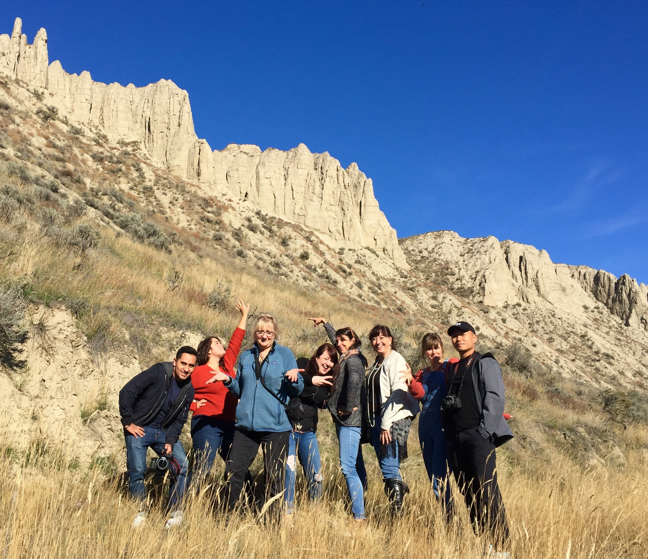
Press Trips
Notes:
Individual vs group press trips.
DIFFERENCES BETWEEN INTERNATIONAL TRADE
AND NORTH AMERICAN CONSUMER PRESS TRIPS
Keep it real
PACING – important to have free time to explore
SOME ELEMENTS DON’T MIX – think of needs of film crews and photographers
Be clear about expectations and commitments

Slide 17
Visiting Journalist Program
TWEEDSMUIR PROVINCIAL PARK
CARIBOO CHILCOTIN COAST
Notes:
DMOs and tourism businesses in British Columbia are eligible for Destination BC’s assistance through our North America Visiting Journalist Program. Criteria such as audience size and demographics are considered and our investment is towards air and ground costs.
This program allows us to enable industry but provide support for media trips which are aligned with DBC’s core target market and audience.

Slide 18
Trends
Lifestyle
Second tier cities and lesser known destinations
Character driven stories
Less planning and more serendipity
Rethinking influencers
NIMPO LAKE
CARIBOO CHILCOTIN COAST

Slide 19
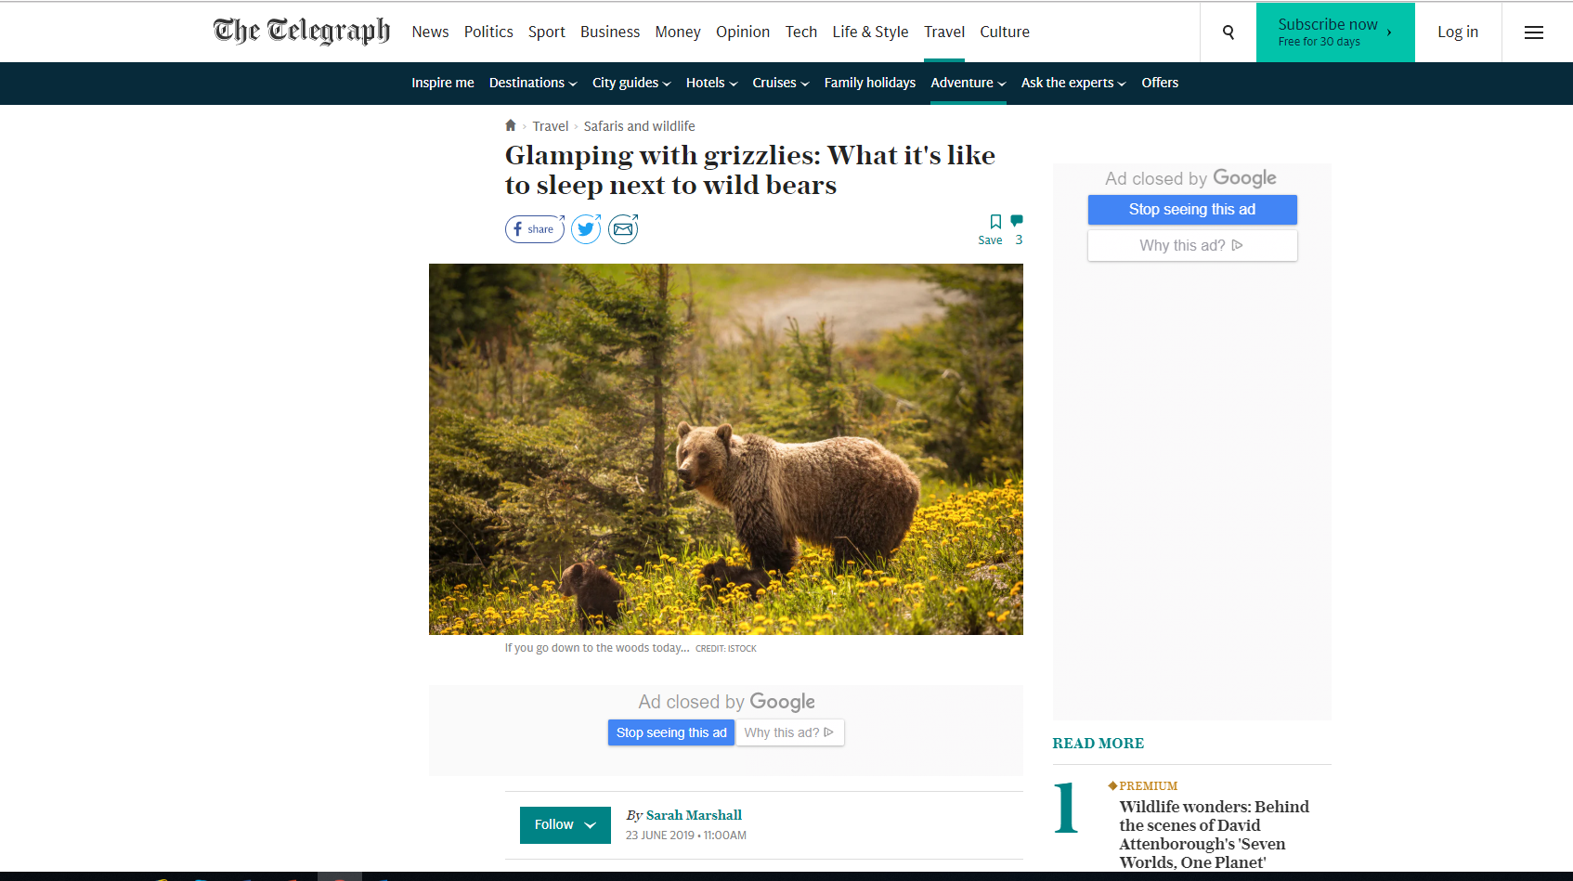

Slide 20
APE LAKE
CARIBOO CHILCOTIN COAST

Slide 34
Questions?
TWEEDSMUIR PROVINCIAL PARK
CARIBOO CHILCOTIN COAST

